Slide 1
Unit 10
L’art (art)

Slide 2
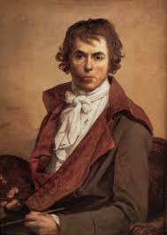
Jacques-Louis David
Classicism

Slide 3
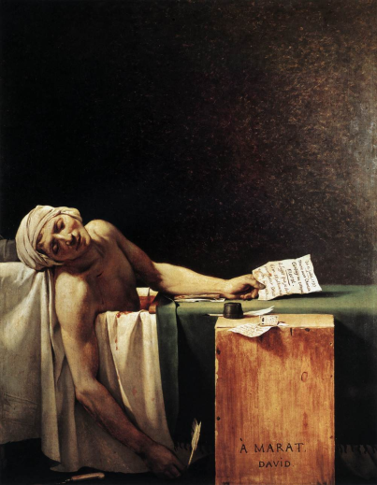
Jacques-Louis David
David helped establish the movement of Classicism in French Art.
He admired ancient Greek art and created several painting with Greek mythological and historical themes.
He used clear lines to give the human body a realistic and natural appearance.
Three of his Classical masterpieces are:

Slide 4
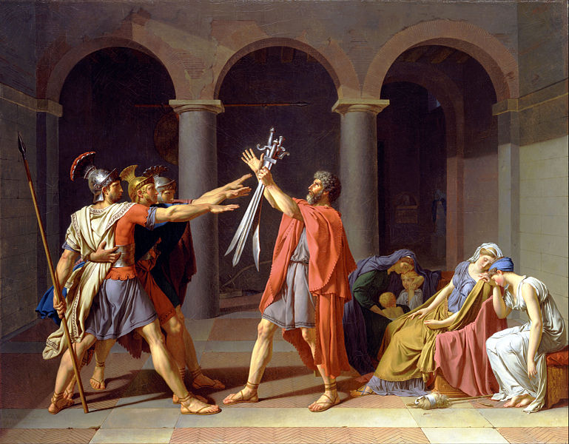
Oath of the Horatii

Slide 5
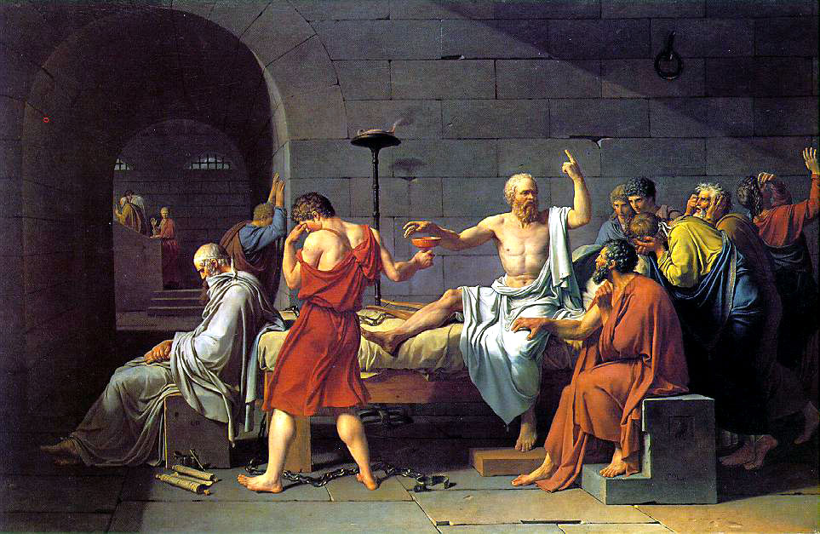
The Death of Socrates

Slide 6
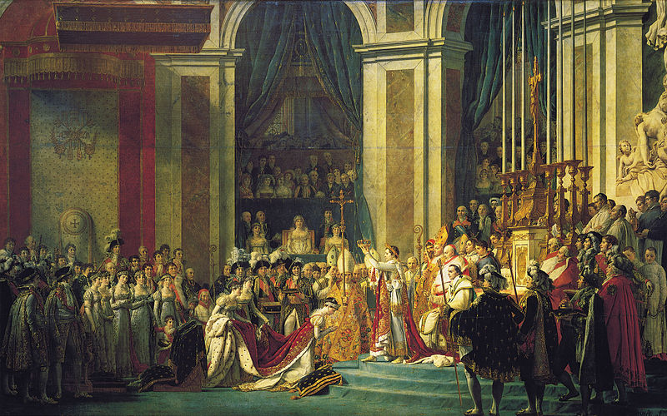
Coronation (of Napoleon)

Slide 7
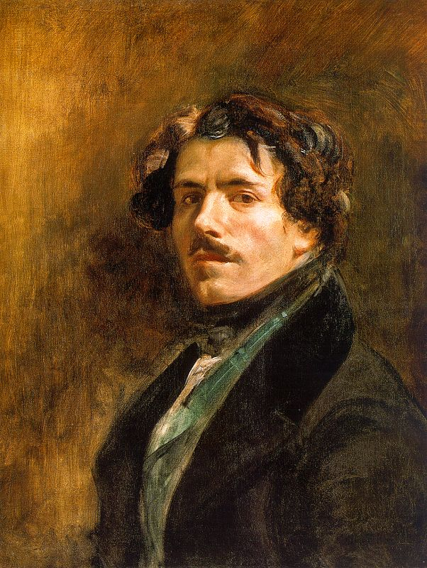
Eugène Delacroix
Romanticism

Slide 8
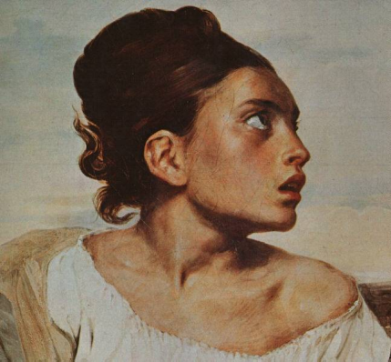
Eugène Delacroix
Believed that Classical artists of his time had removed feeling from art, making it lifeless and cold like a stone sculpture.
Used flowing lines to create the illusion of movement, varying shades of color to portray feeling, and contrast to produce liveliness.
Believed a painting must be felt as well as viewed.
A few of his Romantic masterpieces are:

Slide 9
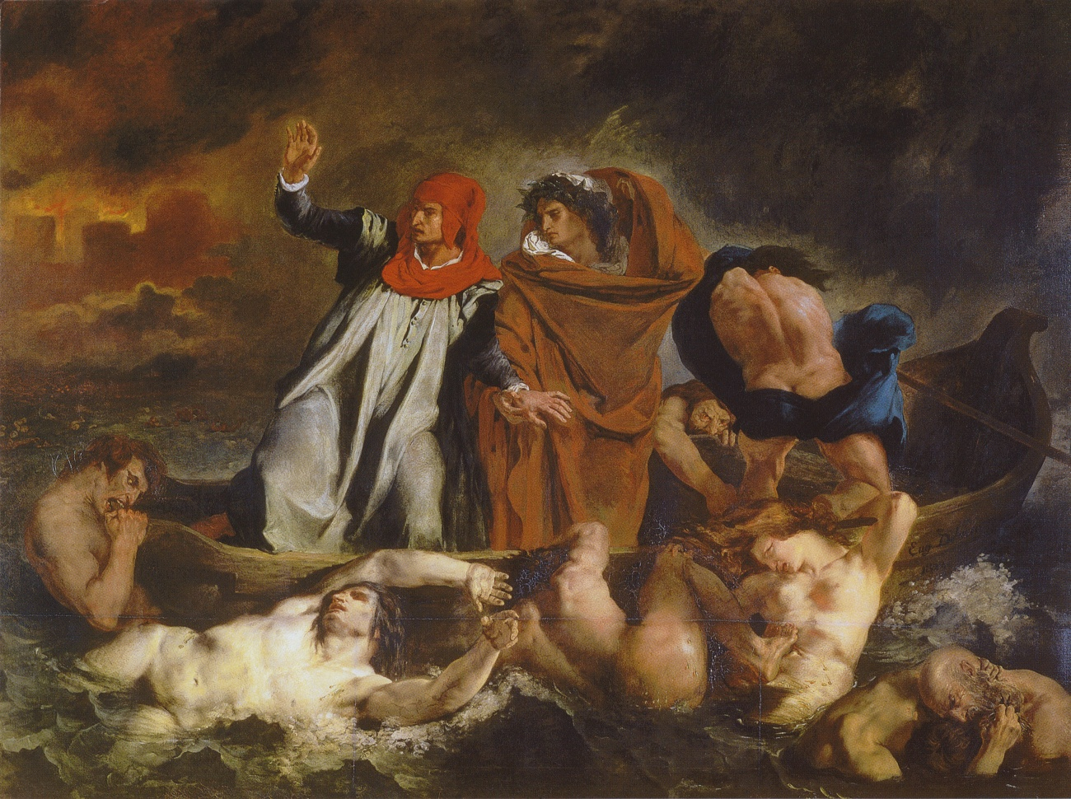
The Barque of Dante

Slide 10
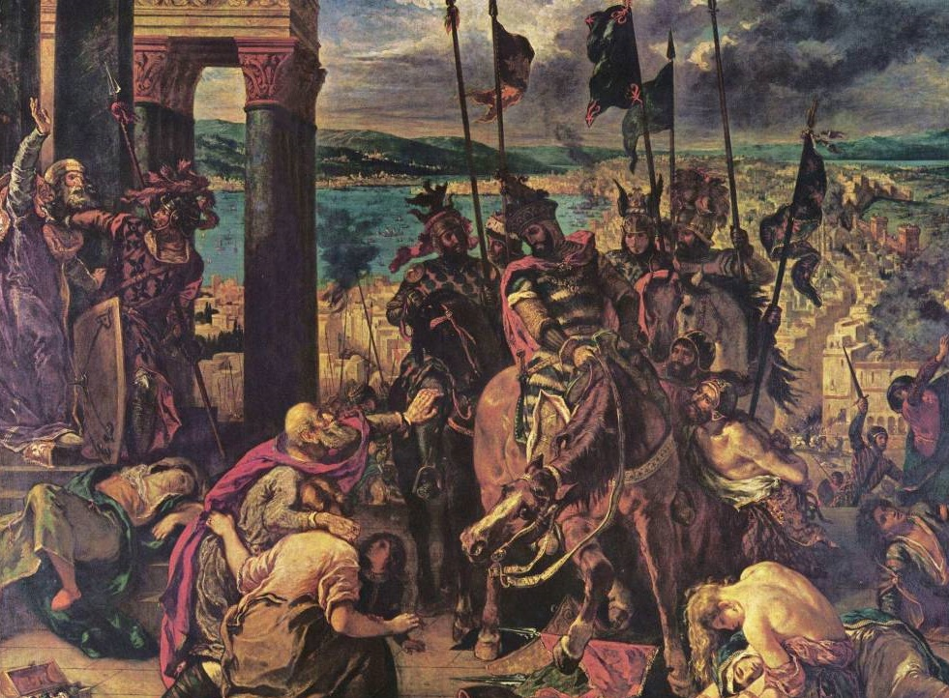
The Fall of Constantinople

Slide 11
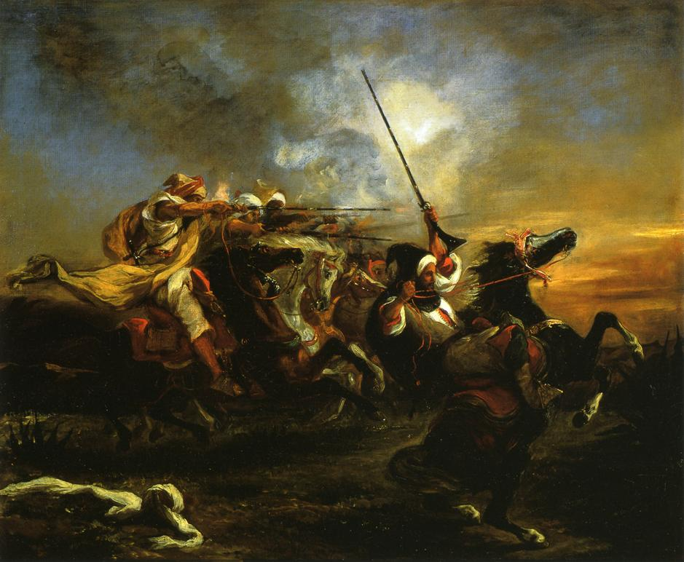
Moroccan Horseman in Military Action

Slide 12
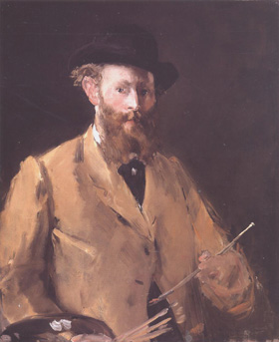
Édouard Manet
Impressionism

Slide 13
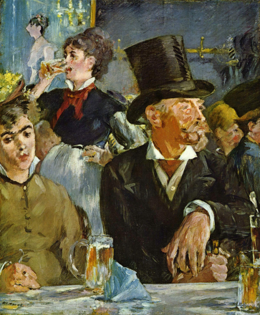
Édouard Manet
One of the founders of the French School of Impressionism.
Believed that a painting should create an immediate impression on the viewer.
Believed that details were not needed to convey an impression.
Used techniques of ghost effect, blending and merging of color, and the joining of the foreground with the background.
A few of his Impressionist paintings are:

Slide 14
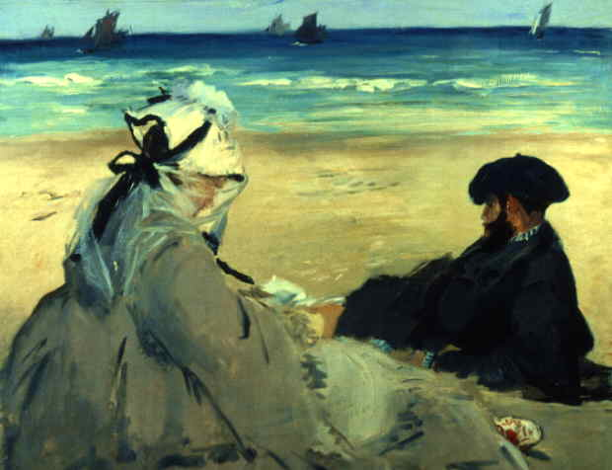
On the Beach

Slide 15
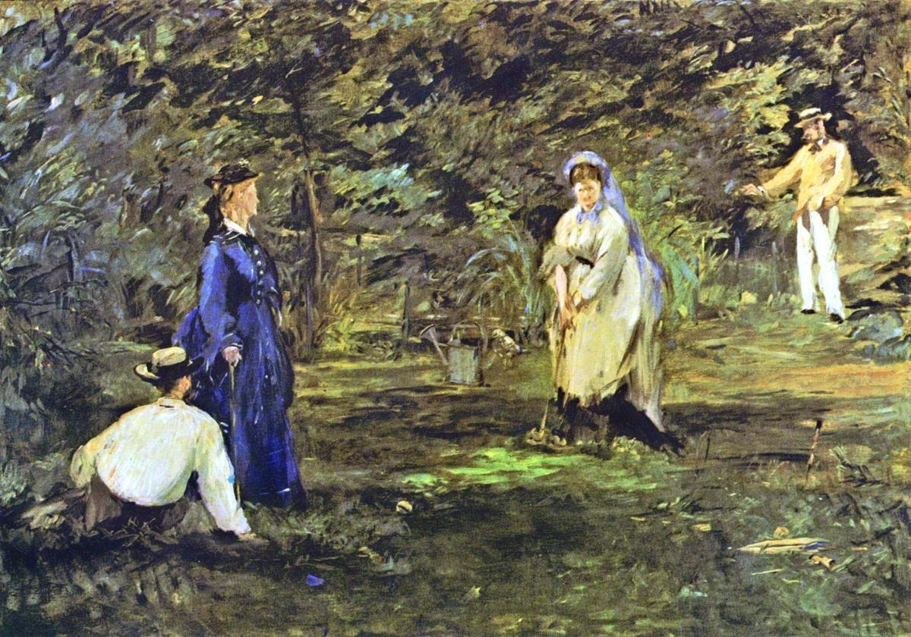
The Croquet Match

Slide 16
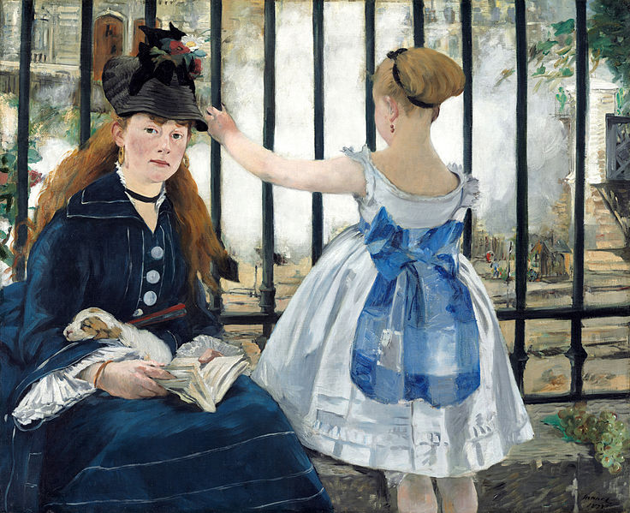
The Railway

Slide 17
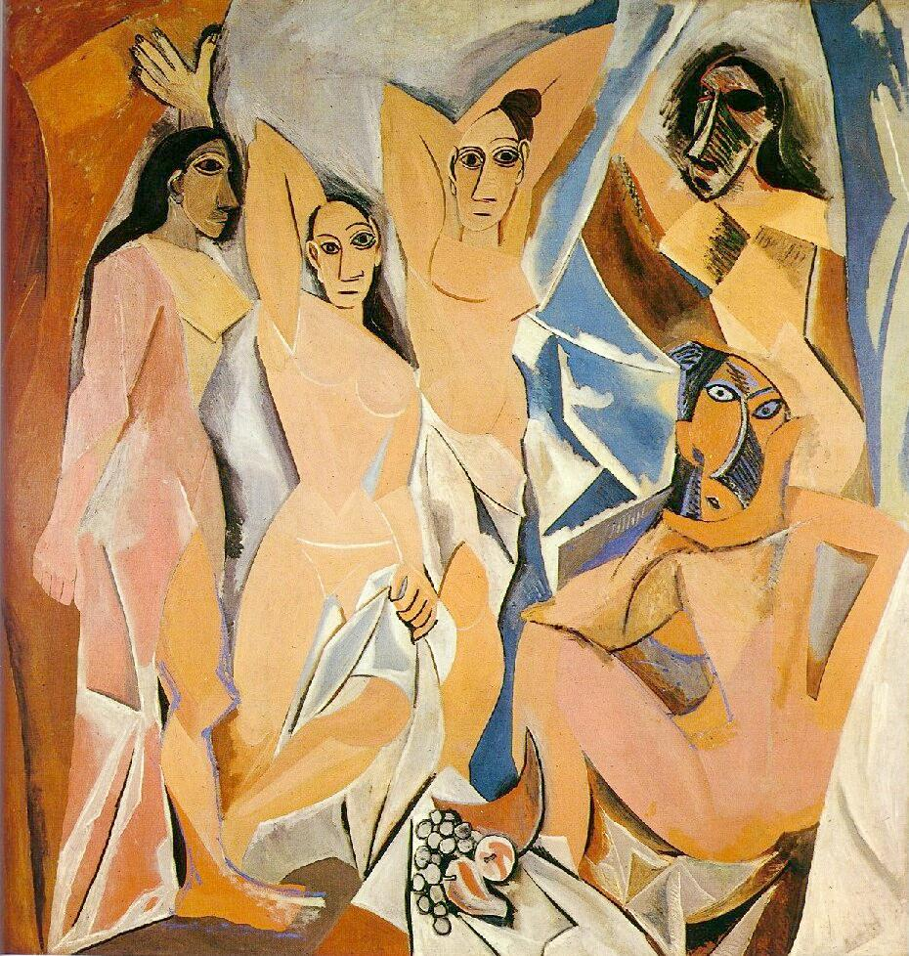
Contemporary Artists

Slide 18
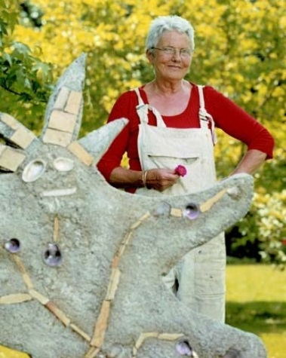
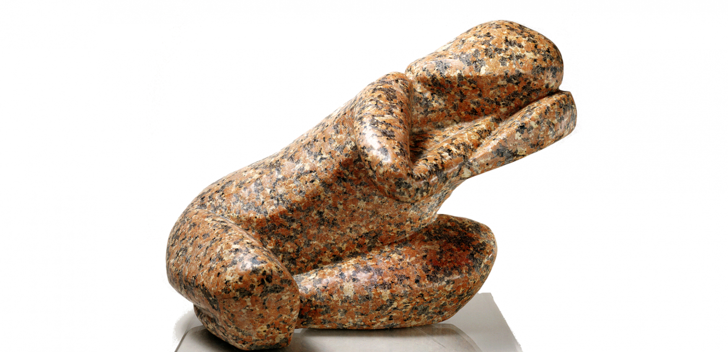
Catherine Mandron
Sculpts objects out of marble, glass, and stone.

Slide 19
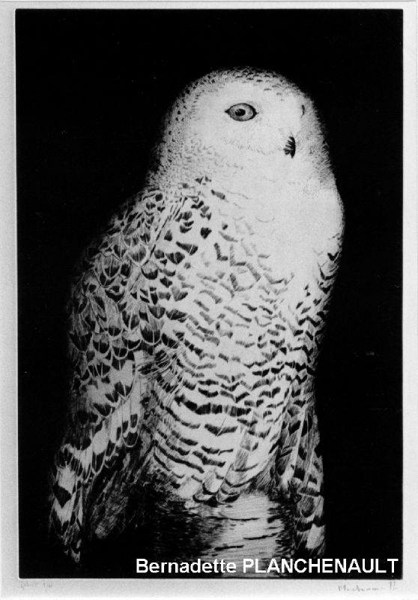
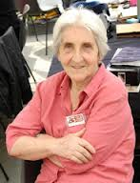
Bernadette Planchenault
Uses animals in her etchings and paintings.

Slide 20
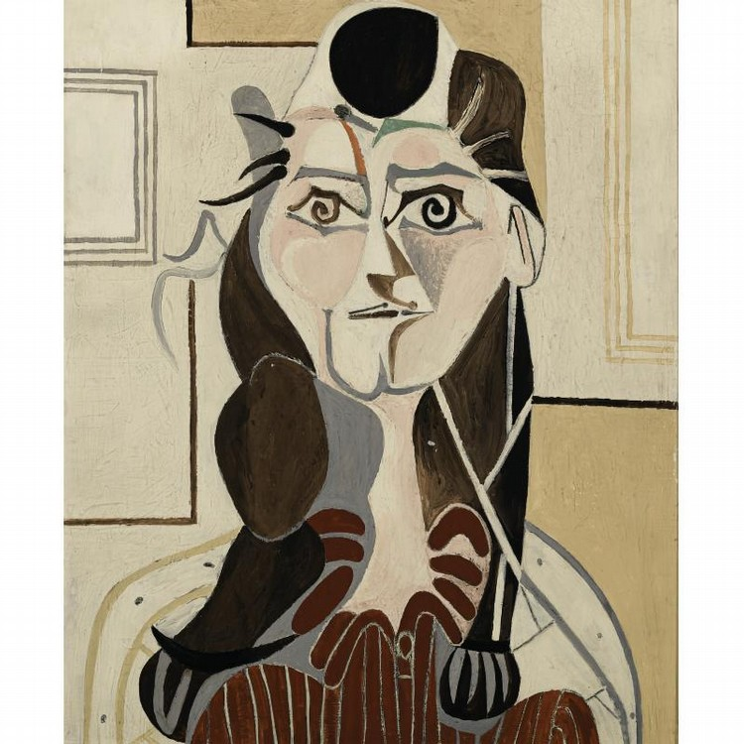
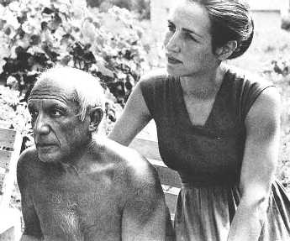
Françoise Gilot
Creates oil paintings in a very modern style, influenced greatly by the Spanish painter, Pablo Picasso.

Slide 21
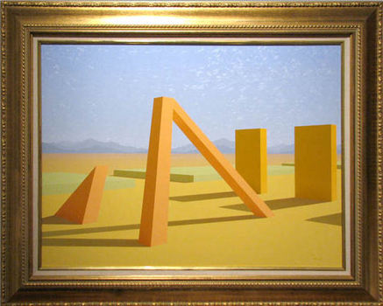
Daniel Peccoux
Uses groupings of stone and shadow to evoke shapes in a new way, as in Pyramid. (Pyramide)

Slide 22
Fin

